Slide 1
Modeling State Legislative Elections
By Eric Stone

Slide 2
Goal
To create an effective model for predicting state legislative races in all 50 states in order to aid in resource allocation
Classify every race as either safe Republican, Democratic, or toss-up

Slide 3
Methodology

Slide 4
National Model
CatBoostClassifier
~80% Accuracy
~42% of toss-ups properly classified
Random Forest Classification
~85% Accurate
~47% of toss-ups properly classified

Slide 5
50 State Models
Ran all 50 states through 6 models to determine the best models for each
Average accuracy ~81%
Most states performed worse
Possible correlation between strong state models and state population
NY, CA, TX among best
RI, WV, SD among worst

Slide 6
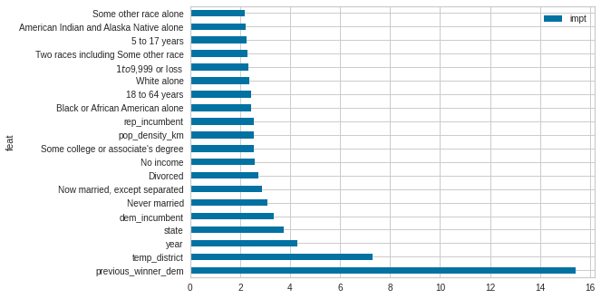
Most Influential factors
According to CatBoostClassifier Model

Slide 7
Results
Seat history is most important
Democratic Incumbency stronger indicator than Republican
Percentage of lower income people stronger indicator than higher income

Slide 8
Conclusion
Modeling electoral outcomes accurately requires a great deal of context. State legislative races are particularly challenging due to lack of general attention or polling.

Slide 9
Further Steps
Further data manipulation including Feature Unions
Collecting district info from commercial sources
Expand time period analyzed
Analyze relationship between up ballot and down ballot races
Presence of state-wide and federal races
Effect on turnout and relation to outcome

